Slide 1
Kubernetes
CONTAINER ORCHESTRATION
An open-source platform that deploys, scales and manages containerized applications across a cluster of machines.
The name is Greek for “helmsman” or “pilot”. In K8s, the 8 stands for the eight letters between K and s.
What it does
How it works
Core building blocks
Decides which machine runs each container, restarts containers that fail and scales them with demand.
You declare the desired state in YAML. Controllers compare it with the actual state and close any gap.
Pods run containers, Deployments keep the right number of Pods running and Services give them a stable address.
Notes:
Kubernetes takes containers built with tools such as Docker and runs them across many machines as one system. The key idea is the declarative model: you state what you want, for example three replicas of a web app, and Kubernetes keeps working to make the cluster match. Pods, Deployments and Services are the first objects most people work with.

Slide 2
How Kubernetes came to be
HISTORY
2003–2004
Borg
Google’s internal cluster manager runs its own services
2013
Docker
Docker makes containers easy to package and run
June 2014
Open-sourced
Google releases it, built on lessons from Borg and Omega
July 2015
Version 1.0
First stable release; Google donates it to the newly formed Cloud Native Computing Foundation (CNCF)
2017
Industry backing
Docker, Amazon Web Services and Microsoft Azure announce support
March 2018
Graduation
The first project to graduate from the foundation
May 2022
dockershim removed
Version 1.24 drops built-in Docker Engine support; Docker images still run
August 2026
Version 1.37
Latest minor release, themed “Garhwal”; three ship each year
Notes:
Kubernetes reused ideas from Borg and its successor Omega, but its code was written from scratch in Go. Key dates: open-sourced on 6 June 2014; version 1.0 on 21 July 2015, when it became the seed project of the newly formed Cloud Native Computing Foundation (CNCF); first project to graduate from the foundation, on 6 March 2018. Graduated is the foundation’s highest maturity level, above sandbox and incubating. In 2017 Docker, Microsoft Azure and Amazon Web Services announced Kubernetes support; the managed cloud services that followed are Azure Kubernetes Service (AKS) and Amazon Elastic Kubernetes Service (EKS). Version 1.24 (May 2022) removed dockershim, so clusters now use runtimes that implement the Container Runtime Interface (CRI), such as containerd or CRI-O. Images built with Docker follow the Open Container Initiative (OCI) image format and still run. Version 1.37, themed “Garhwal” after the Himalayan region of Uttarakhand, was released on 26 August 2026, and version 1.38 is expected in December 2026. Sources: kubernetes.io, CNCF, IBM, InfoQ.

Slide 3
What Kubernetes does for you
ADVANTAGES
Self-healing
Automatic scaling
Rolling updates
Uses health checks to restart failed containers and replace Pods on lost nodes.
Adds or removes Pods as load changes. Node autoscalers resize the cluster itself.
Replaces Pods gradually during a release and rolls back with one command.
Service discovery
Resource efficiency
Portability
Gives each Service a stable DNS name and spreads requests across its Pods.
Packs Pods onto nodes by CPU and memory requests, so less capacity sits idle.
The same manifests run on any conformant cluster, on-premises or in any cloud.
Notes:
Each advantage maps to a feature: liveness and readiness probes (self-healing); the Horizontal Pod Autoscaler plus a node autoscaler such as Cluster Autoscaler or Karpenter (scaling); Deployments and kubectl rollout undo (rolling updates); Services and cluster DNS (discovery and load balancing); resource requests and limits used by the scheduler (efficiency); and the Certified Kubernetes conformance program (portability).

Slide 4
When Kubernetes is the right fit
WHEN TO USE
Good fit
Think twice
Many services
One app or a few containers
Microservices that scale independently
Docker Compose or a single VM is simpler
Variable traffic
A small team without ops skills
Needs autoscaling and automatic failover
A PaaS like Cloud Run or Azure App Service
Frequent releases
Short, event-driven jobs
Teams shipping often through CI/CD
Serverless functions such as AWS Lambda
Hybrid or multi-cloud
Low traffic, tight budget
One way to deploy across environments
Cluster overhead can outweigh the gains
Rule of thumb: adopt it when managing containers by hand costs more than running a cluster.
Notes:
Kubernetes brings its own operating work: networking, storage, access control (RBAC) and regular upgrades, since each minor release gets roughly a year of patch support. Managed services such as Amazon EKS, Azure AKS and Google GKE run the control plane for you, which lowers the entry cost but not the learning curve. For a single service, Docker Compose, a VM, a PaaS or serverless functions are often faster to set up and cheaper to run.

Slide 5
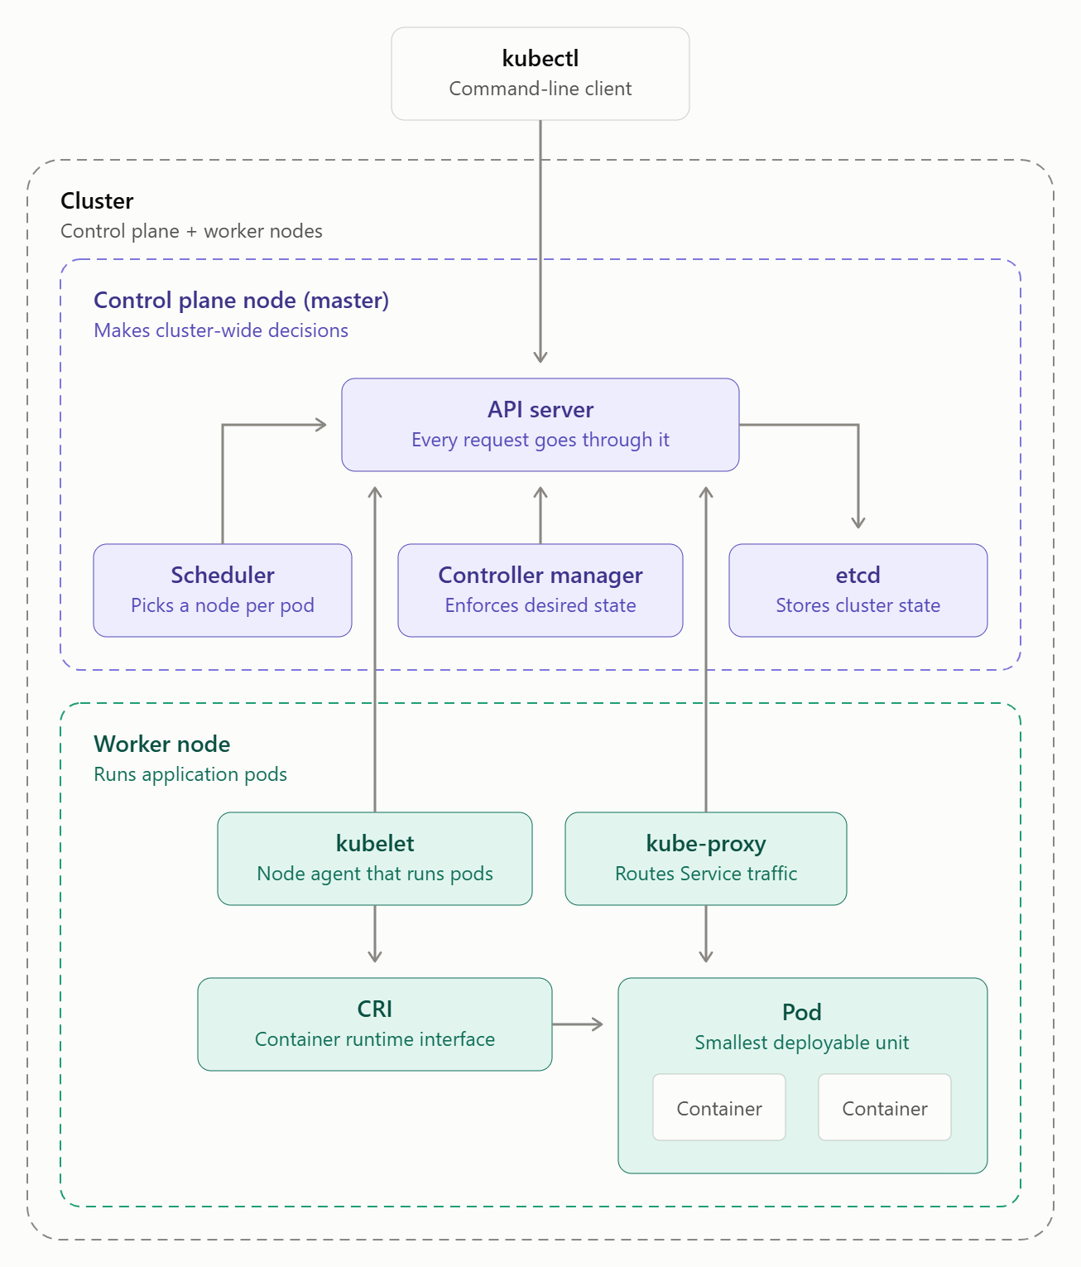
How a cluster works
ARCHITECTURE
01
kubectl sends each request to the API server, which records cluster state in etcd.
02
The scheduler assigns new Pods to nodes, and the controller manager keeps actual state matching desired state.
03
On the chosen node, the kubelet starts the Pod’s containers through the container runtime interface (CRI).
04
kube-proxy routes Service traffic to the right Pods.
Notes:
Walk the arrows from the top. Every request, from kubectl or from any other component, goes through the API server, and only the API server reads and writes etcd. The scheduler watches for Pods that have no node yet and assigns one. Controllers in the controller manager compare desired and actual state and act on the difference. On each worker node, the kubelet asks the container runtime (for example containerd or CRI-O, through the Container Runtime Interface) to start the Pod’s containers, and kube-proxy sets up network rules so Service traffic reaches the right Pods. Older material calls the control plane node the “master”; current Kubernetes documentation uses “control plane”.

